Slide 1
System Integration
Don’t put the square peg in the round hole

Slide 2
Before we start...
Meet this guy:
Call me Professor MJ!
He’s Michael; you can call him MJ–or whatever else you can think of.

Slide 3
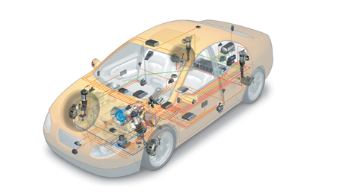
Hey MJ, what’s a system?
Independently functioning mechanisms that accomplish a task
All these systems combined create the finished robot
Some systems include:
drive
control
sensors
game-piece interaction
System integration is how each of these interact with each other

Slide 4
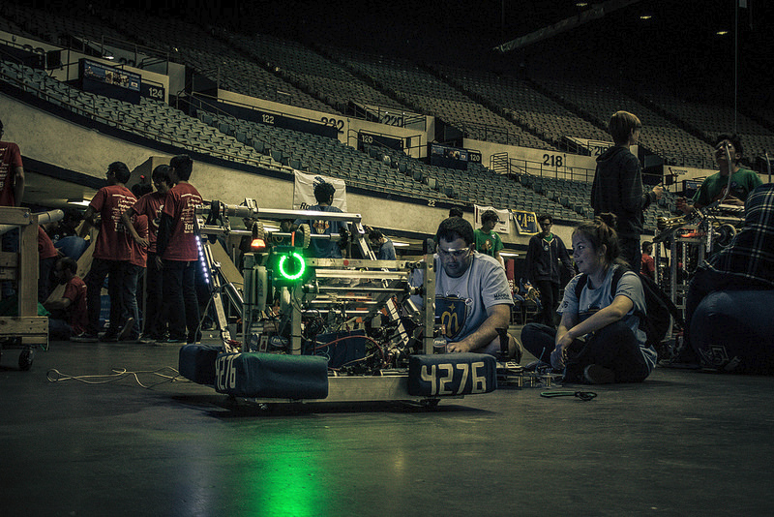
Behrooz Cruise: The Legend
From ages past, we are left with the irrefutably epic, Behrooz Cruise:

